Slide 1
Scalable Multi-Period Optimal Power Flow for Active Power Distribution Systems or simply, Scalable MP-OPF in ADS
Aryan Ritwajeet Jha
Graduate Research Assistant
Washington State University
Notes:
Remember to hit the reset button to make sure all the page elements react properly.
There are 20 different layouts that you can choose from.

Slide 2
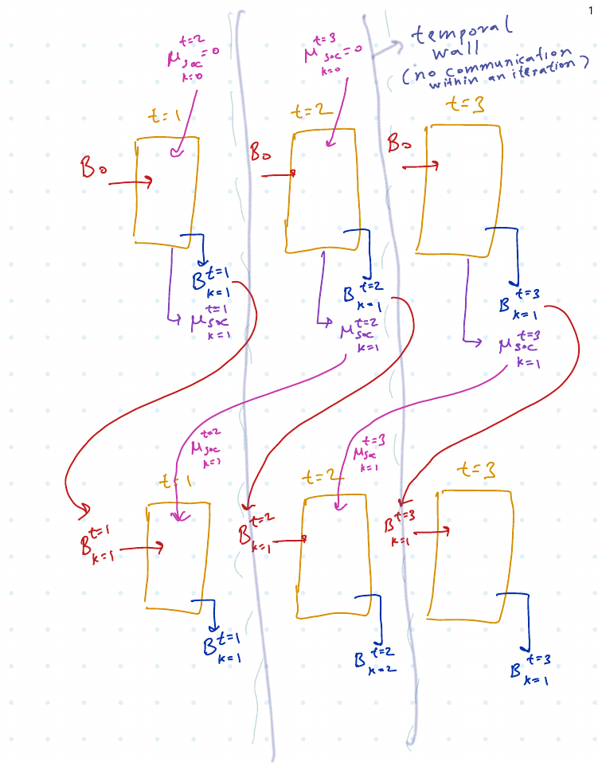
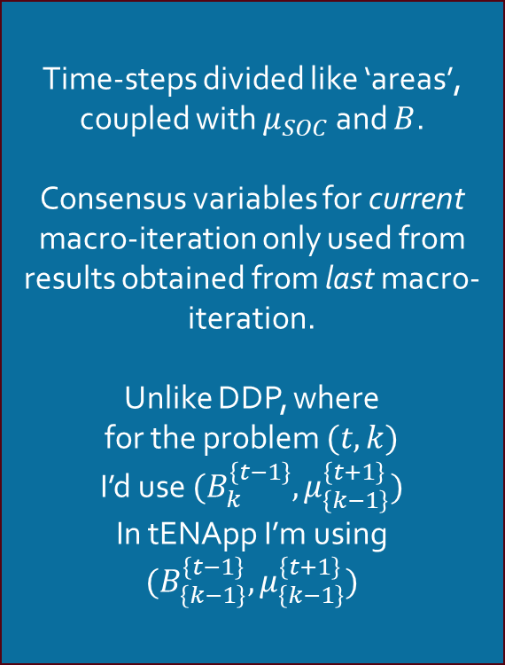

tENApp Algorithm Terminal SOC Constraint Relaxed
$$tENApp$$
Time-steps divided like ‘areas’, coupled with $μ_{SOC}$ and $B$.
Consensus variables for current macro-iteration only used from results obtained from last macro-iteration.
Unlike DDP, where
for the problem $(t, k)$
I’d use $(B_{k}^{\left\{t−1\right\}}, μ_{\left\{k−1\right\}}^{\left\{t+1\right\}})$
In tENApp I’m using $(B_{\left\{k−1\right\}}^{\left\{t−1\right\}}, μ_{\left\{k−1\right\}}^{\left\{t+1\right\}})$

Slide 3
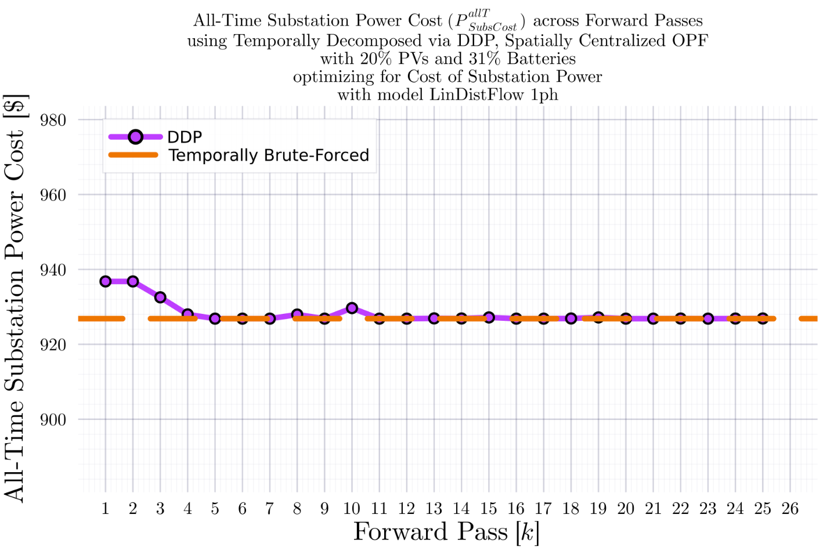
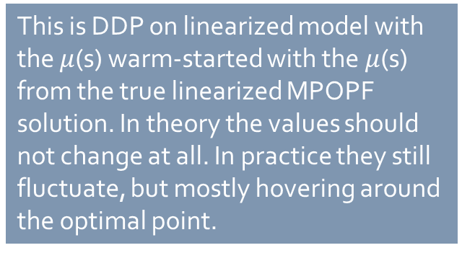
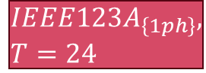
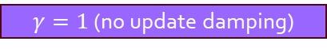


DDP Trajectory vs #Forward Passes $[k]$: LinDistFlow Model Terminal SOC Constraint Relaxed
$$IEEE123A_{\left\{1ph\right\}}, T=24$$
BruteForced (BF)
$$DDP$$
This is DDP on linearized model with the $μ$(s) warm-started with the $μ$(s) from the true linearized MPOPF solution. In theory the values should not change at all. In practice they still fluctuate, but mostly hovering around the optimal point.
$γ=1$ (no update damping)
$$k_{Max}=25$$

Slide 4
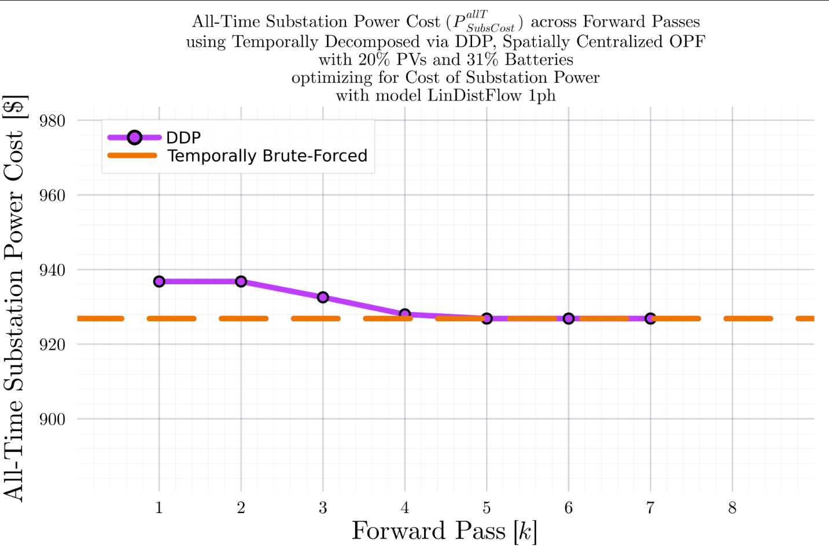
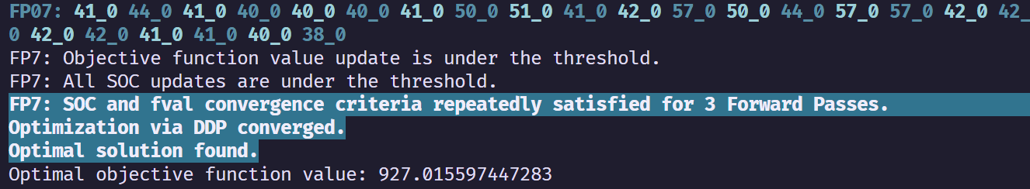
DDP Trajectory vs #Forward Passes $[k]$: LinDistFlow Model Terminal SOC Constraint Relaxed
$$IEEE123A_{\left\{1ph\right\}}, T=24$$
BruteForced (BF)
$$DDP$$
With some ‘convergence-catching’ heuristic in place (declare convergence if SOC and fval are not changing for 3 Forward Passes), DDP converges.
$γ=1$ (no update damping)
$$k_{Max}=25$$

Slide 5
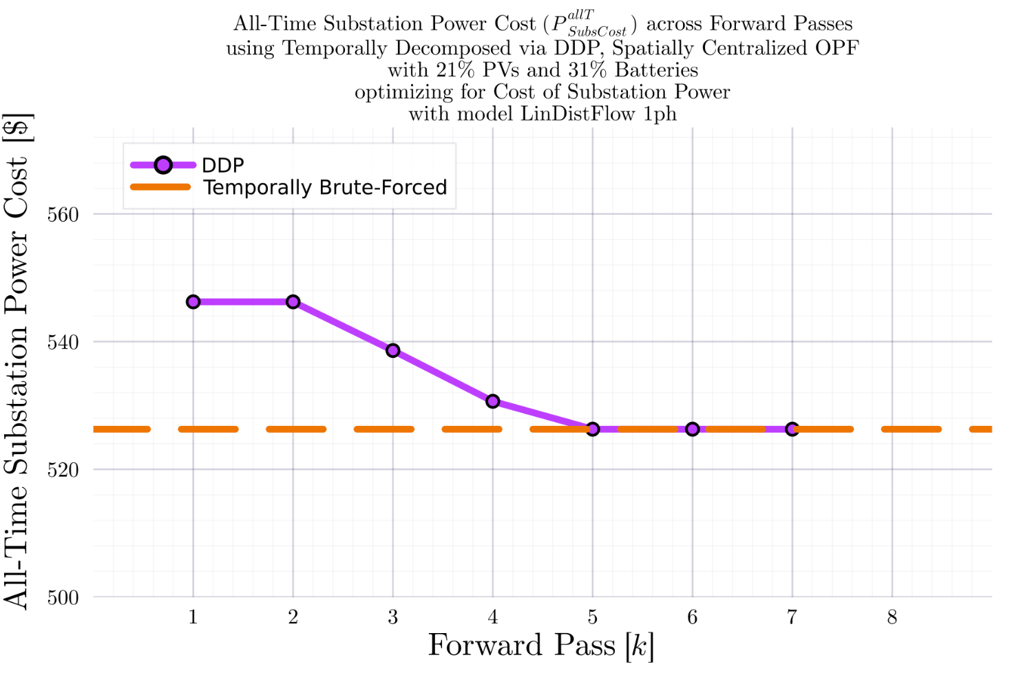
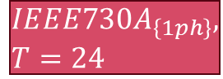
DDP Trajectory vs #Forward Passes $[k]$: LinDistFlow Model Terminal SOC Constraint Relaxed
$$IEEE730A_{\left\{1ph\right\}}, T=24$$
BruteForced (BF)
$$DDP$$
With some ‘convergence-catching’ heuristic in place (declare convergence if SOC and fval are not changing for 3 Forward Passes), DDP converges.
$γ=1$ (no update damping)
$$k_{Max}=25$$

Slide 6
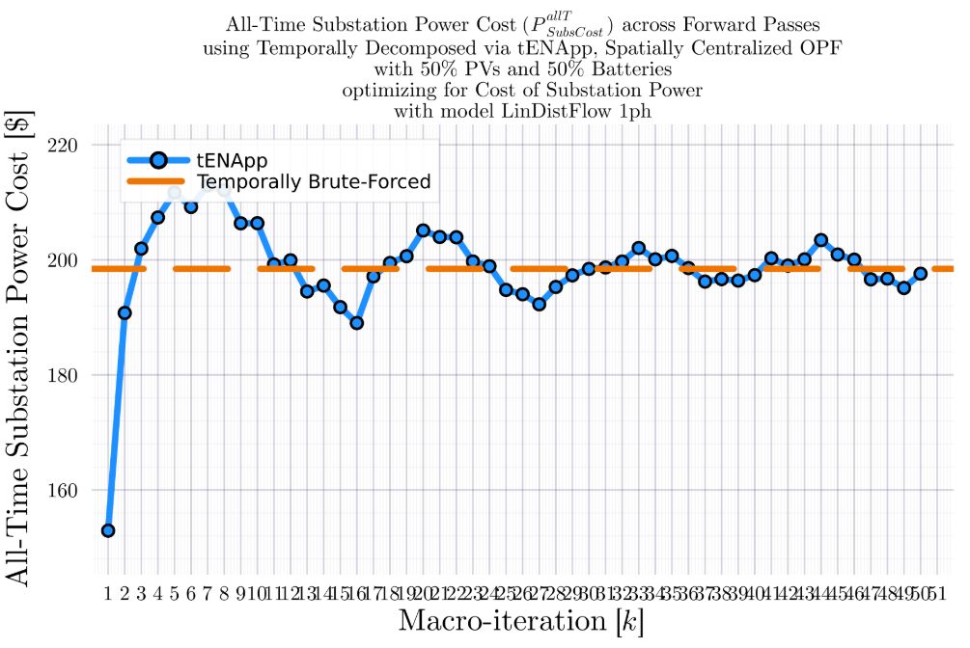
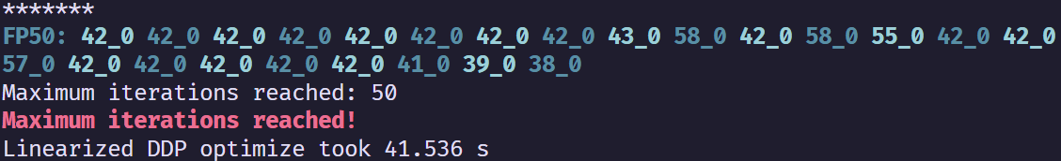
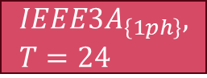



tENApp Trajectory vs #Forward Passes $[k]$: LinDistFlow Model Terminal SOC Constraint Relaxed
$$IEEE3A_{\left\{1ph\right\}}, T=24$$
BruteForced (BF)
$$tENApp$$
$γ=1$ (no update damping)
$$k_{Max}=50$$
$$α=4.00$$

Slide 7
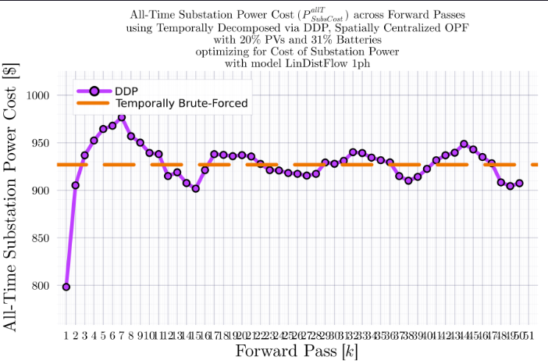
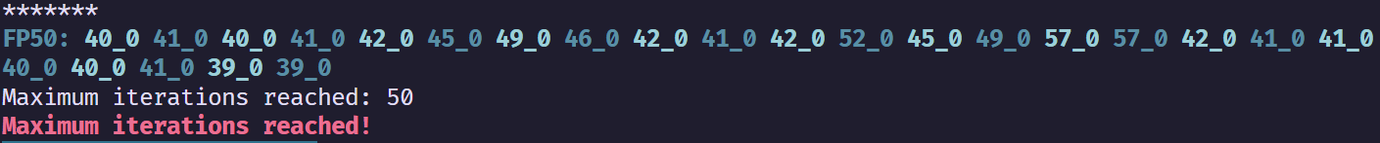
tENApp Trajectory vs #Forward Passes $[k]$: LinDistFlow Model Terminal SOC Constraint Relaxed
$$IEEE123A_{\left\{1ph\right\}}, T=24$$
BruteForced (BF)
$$tENApp$$
$γ=1$ (no update damping)
$$k_{Max}=50$$

Slide 8
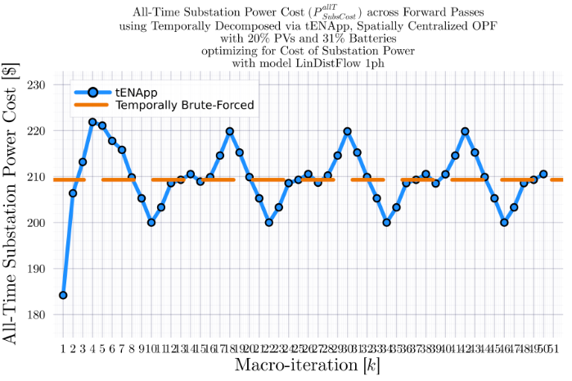
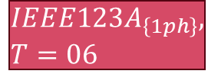

tENApp Trajectory vs #Forward Passes $[k]$: LinDistFlow Model Terminal SOC Constraint Relaxed
$$IEEE123A_{\left\{1ph\right\}}, T=06$$
BruteForced (BF)
$$tENApp$$
$γ=1$ (no update damping)
$$k_{Max}=50$$
$$α=1.00$$

Slide 9

tENApp Trajectory vs #Forward Passes $[k]$: LinDistFlow Model Terminal SOC Constraint Relaxed
$$IEEE123A_{\left\{1ph\right\}}, T=06$$
BruteForced (BF)
$$tENApp$$
$γ=1$ (no update damping)
$$k_{Max}=50$$
$$α=0.43$$

Slide 10

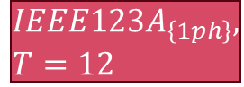
tENApp Trajectory vs #Forward Passes $[k]$: LinDistFlow Model Terminal SOC Constraint Relaxed
$$IEEE123A_{\left\{1ph\right\}}, T=12$$
BruteForced (BF)
$$tENApp$$
$γ=1$ (no update damping)
$$k_{Max}=100$$
$$α=0.43$$

Slide 11
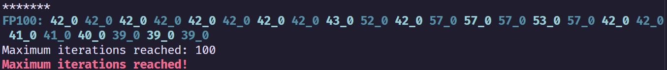

tENApp Trajectory vs #Forward Passes $[k]$: LinDistFlow Model Terminal SOC Constraint Relaxed
$$IEEE123A_{\left\{1ph\right\}}, T=24$$
BruteForced (BF)
$$tENApp$$
$γ=1$ (no update damping)
$$k_{Max}=100$$
$$α=3.00$$

Slide 12
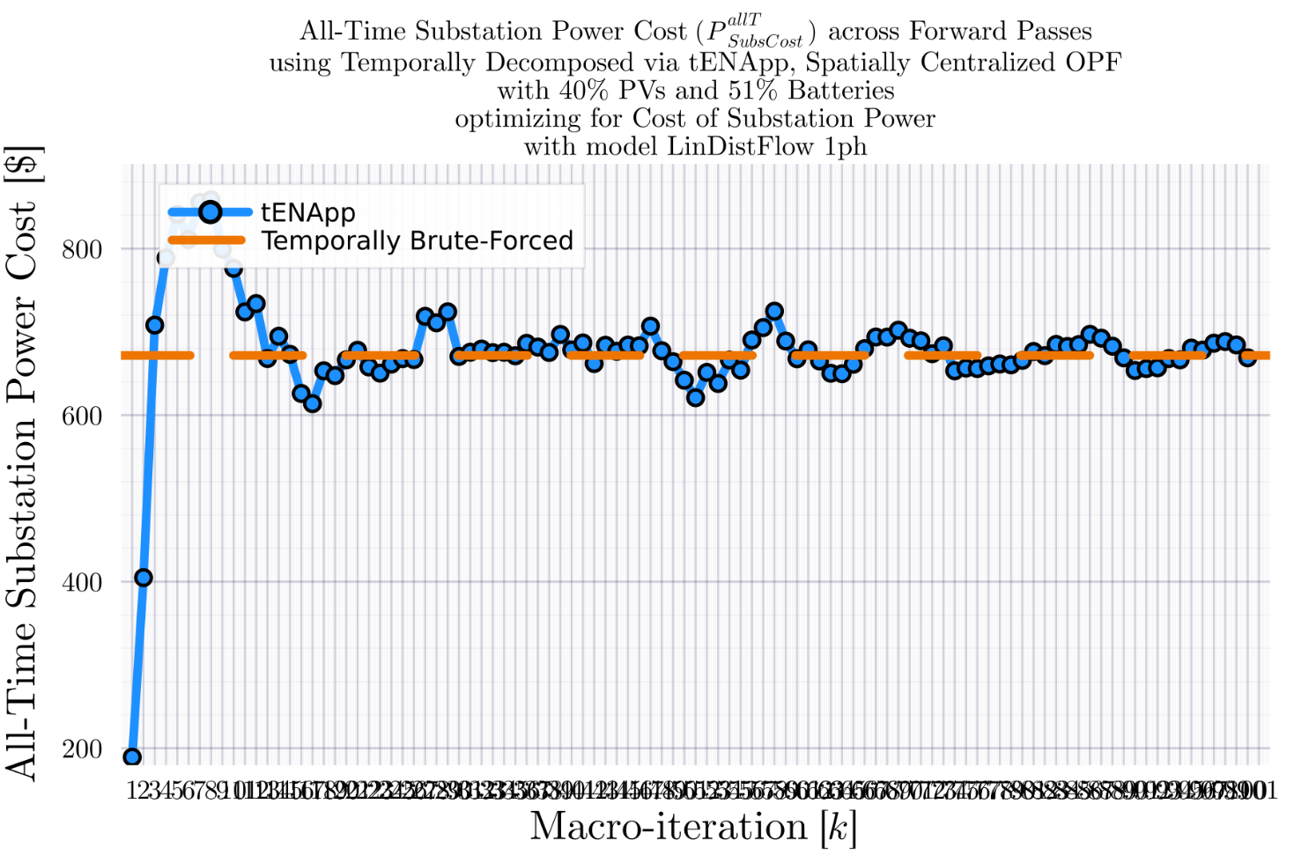
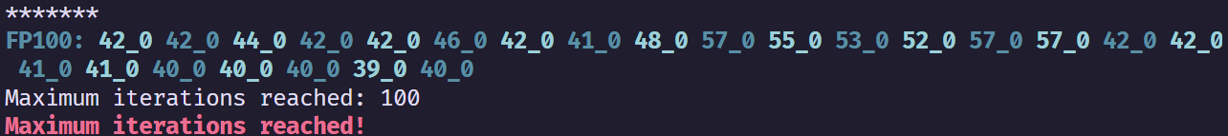
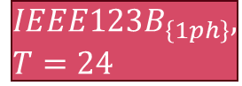
tENApp Trajectory vs #Forward Passes $[k]$: LinDistFlow Model Terminal SOC Constraint Relaxed
$$IEEE123B_{\left\{1ph\right\}}, T=24$$
BruteForced (BF)
$$tENApp$$
$γ=1$ (no update damping)
$$k_{Max}=100$$
$$α=3.00$$

Slide 13

tENApp Trajectory vs #Forward Passes $[k]$: LinDistFlow Model Terminal SOC Constraint Relaxed
$$IEEE123A_{\left\{1ph\right\}}, T=12$$
BruteForced (BF)
$$tENApp$$
$γ=1$ (no update damping)
$$k_{Max}=100$$
$$α=0.75$$

Slide 14
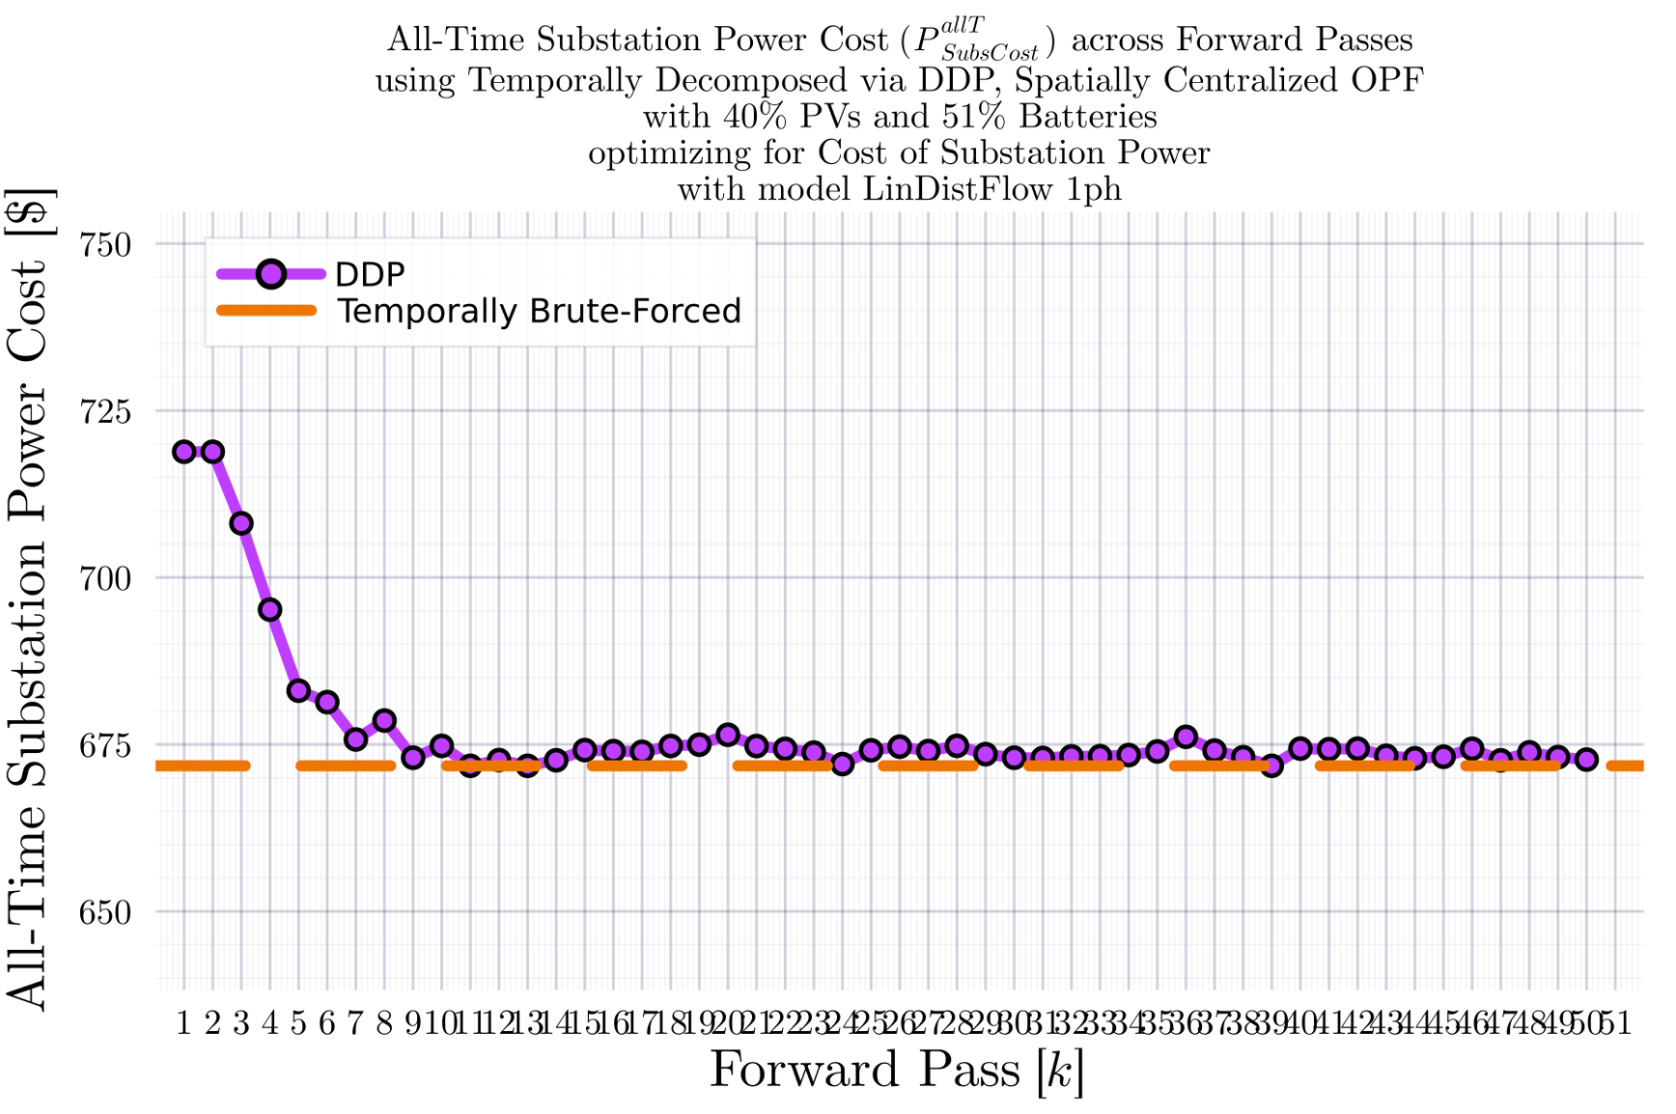

DDP Trajectory vs #Forward Passes $[k]$: LinDistFlow Model Terminal SOC Constraint Relaxed
$$IEEE123B_{\left\{1ph\right\}}, T=24$$
BruteForced (BF)
$$DDP$$
DDP didn’t converge in the given number of iterations..
$γ=1$ (no update damping)
$$k_{Max}=50$$

Slide 15
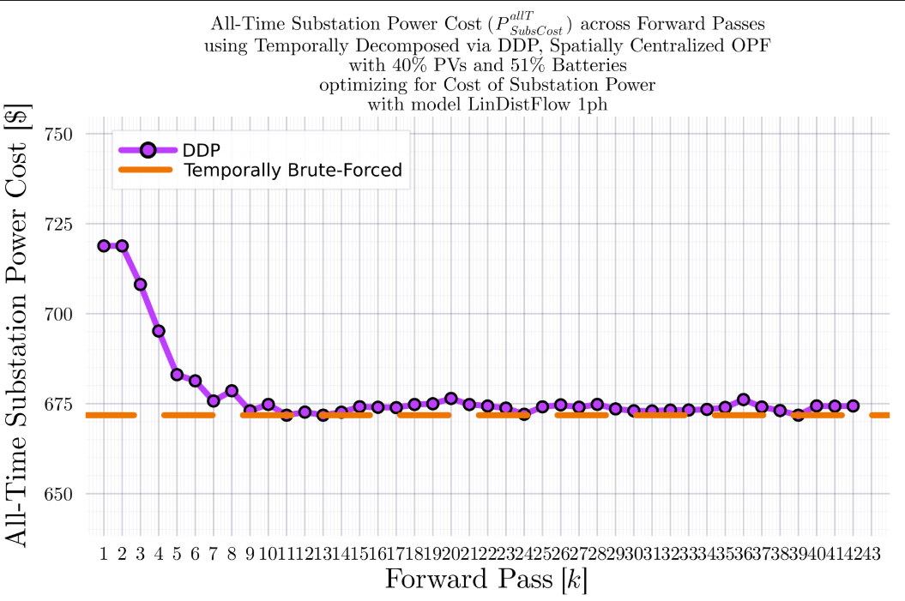
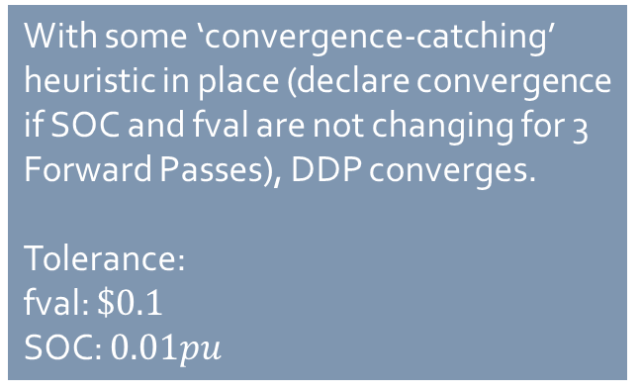
DDP Trajectory vs #Forward Passes $[k]$: LinDistFlow Model Terminal SOC Constraint Relaxed
$$IEEE123B_{\left\{1ph\right\}}, T=24$$
BruteForced (BF)
$$DDP$$
With some ‘convergence-catching’ heuristic in place (declare convergence if SOC and fval are not changing for 3 Forward Passes), DDP converges.
Tolerance:
fval: $\$0.1$
SOC: $0.01pu$
$γ=1$ (no update damping)
$$k_{Max}=50$$

Slide 16

Latest Slides End Here. Previous Slides Follow.

Slide 17
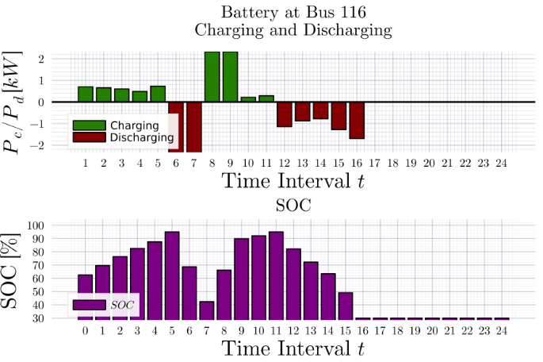
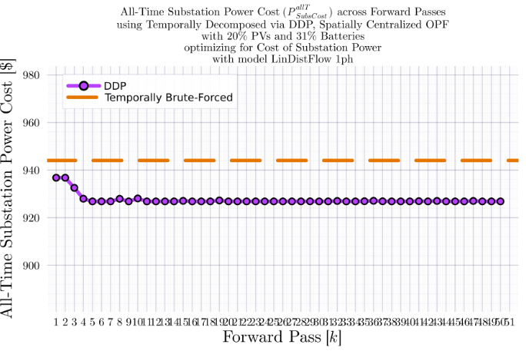
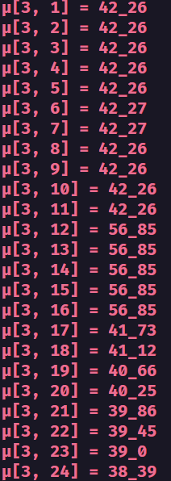
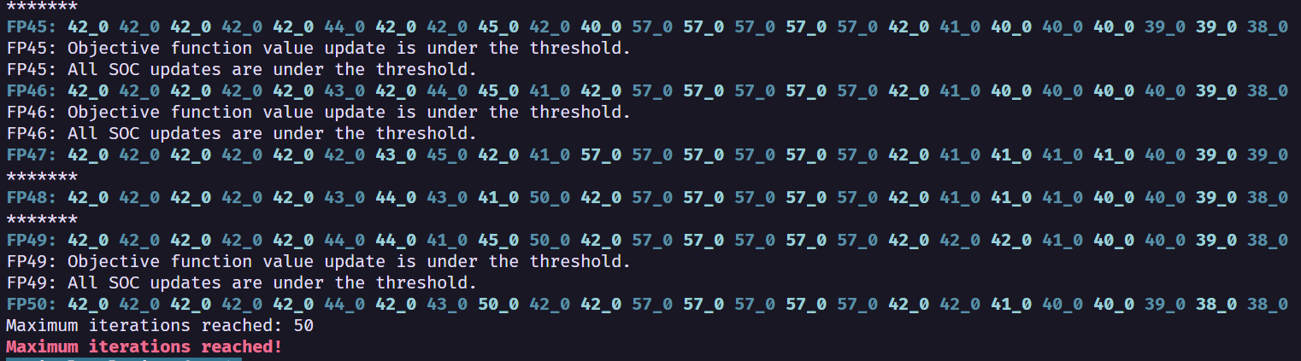
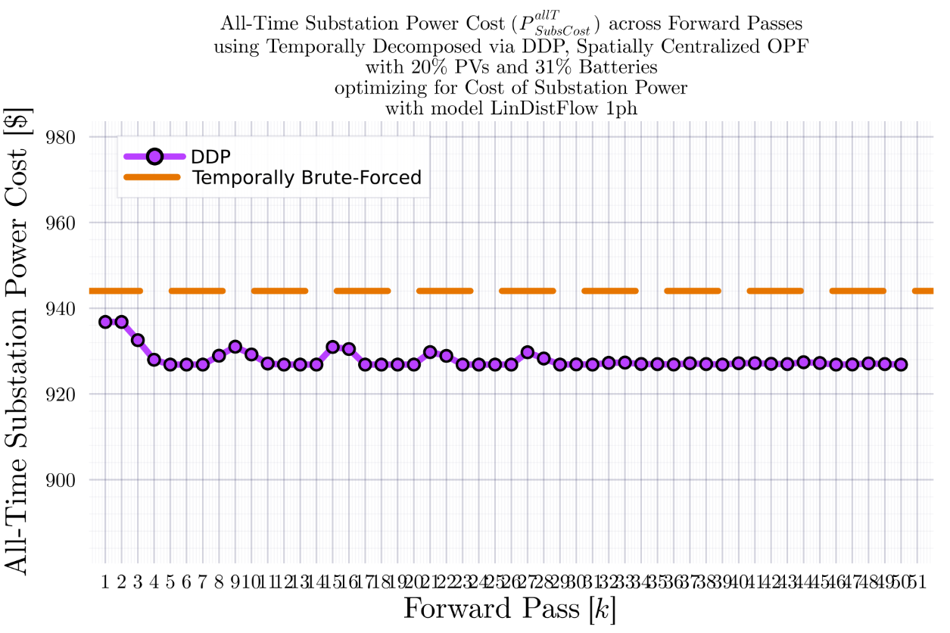
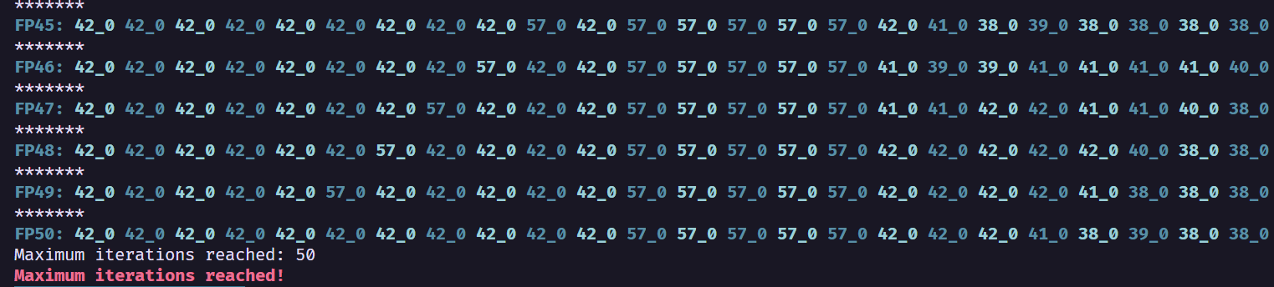
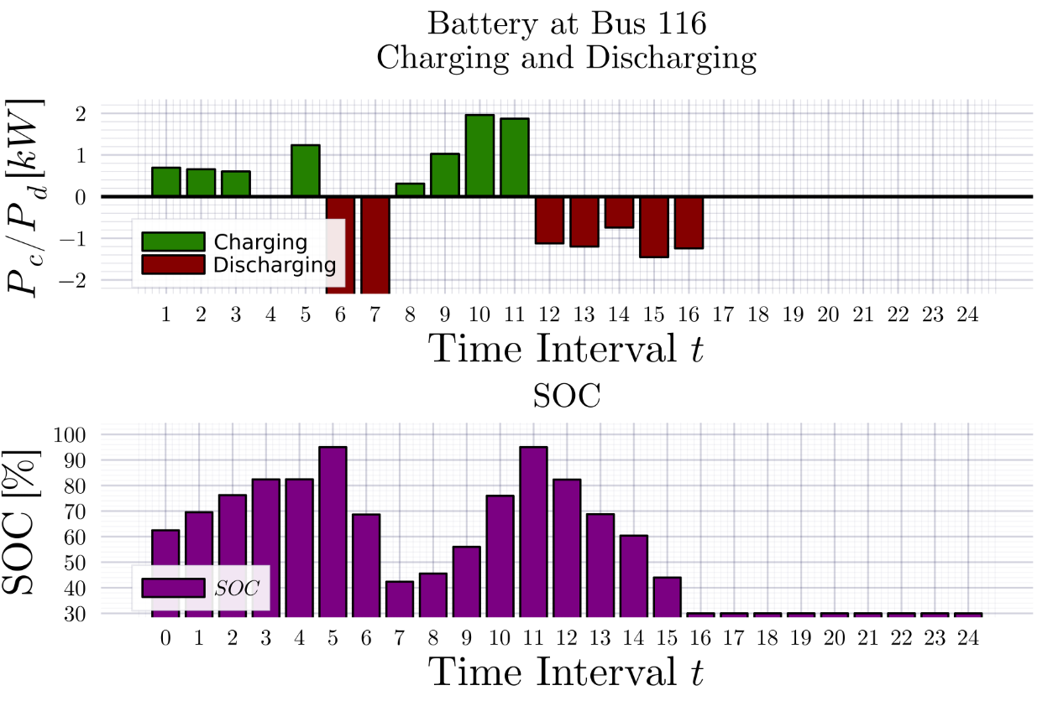
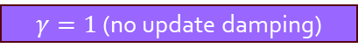

DDP Trajectory vs #Forward Passes $[k]$: LinDistFlow Model Terminal SOC Constraint Relaxed
$$IEEE123A_{\left\{1ph\right\}}, T=24$$
BruteForced (BF)
$$DDP$$
$γ=1$ (no update damping)
$γ=1$ (no update damping)
$$γ=0.5$$
$$γ=0.5$$
$$k_{Max}=25$$

Slide 18
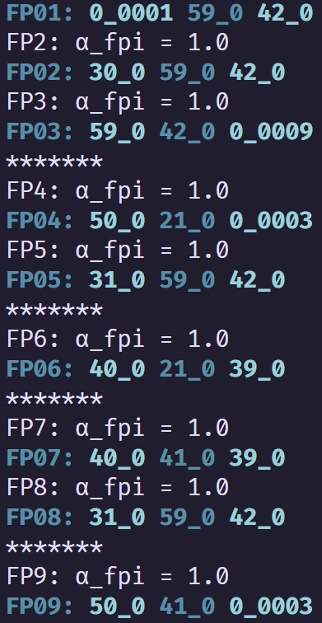
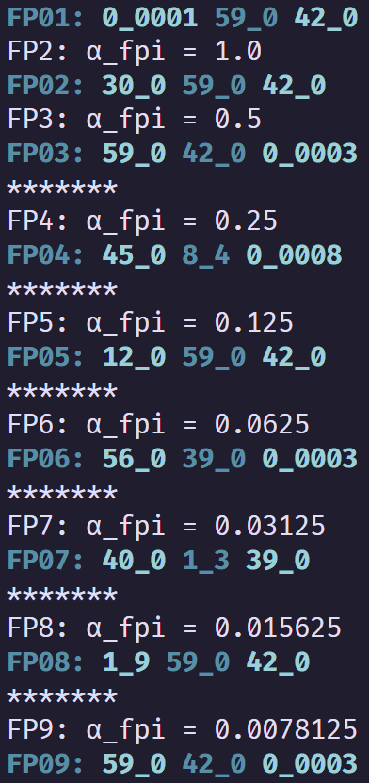
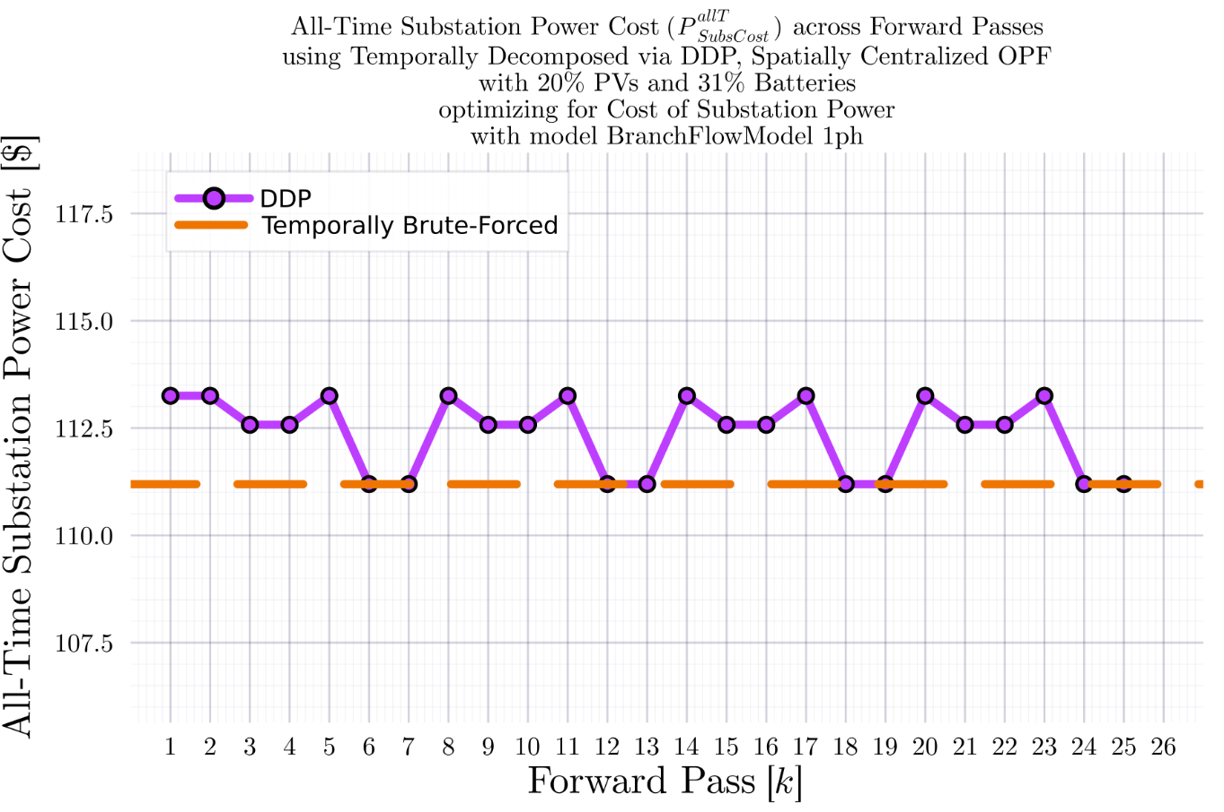
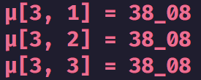

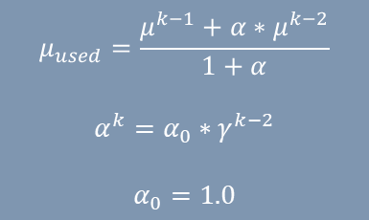
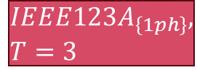



DDP Trajectory vs #Forward Passes $[k]$ Terminal SOC Constraint Relaxed
$$IEEE123A_{\left\{1ph\right\}}, T=3$$
BruteForced (BF)
$$DDP$$
$$FP\left(k\right):μ_{k}\left(t=1\right), μ_{k}\left(t=2\right), μ_{k}(t=3)$$
$$μ_{used}=\frac{μ^{k−1}+α∗μ^{k−2}}{1+α}$$
$$α^{k}=α_{0}∗γ^{k−2}$$
$$α_{0}=1.0$$
$γ=1$ (no update damping)
$$γ=0.5$$
$$k_{Max}=25$$
$γ=1$ (no update damping)
$$γ=0.5$$
Fluctuation ${\text{of} μ}_{k}^{T}$ value between $0$ and a ‘regular’ non-zero value

Slide 19
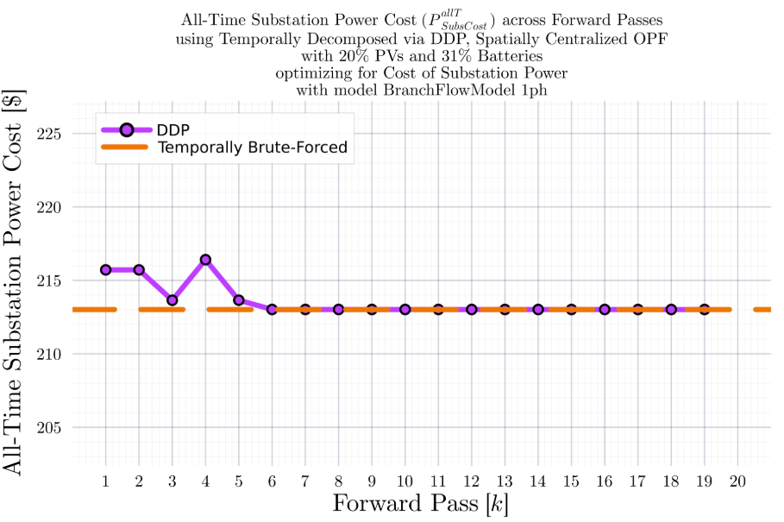
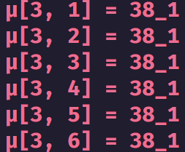
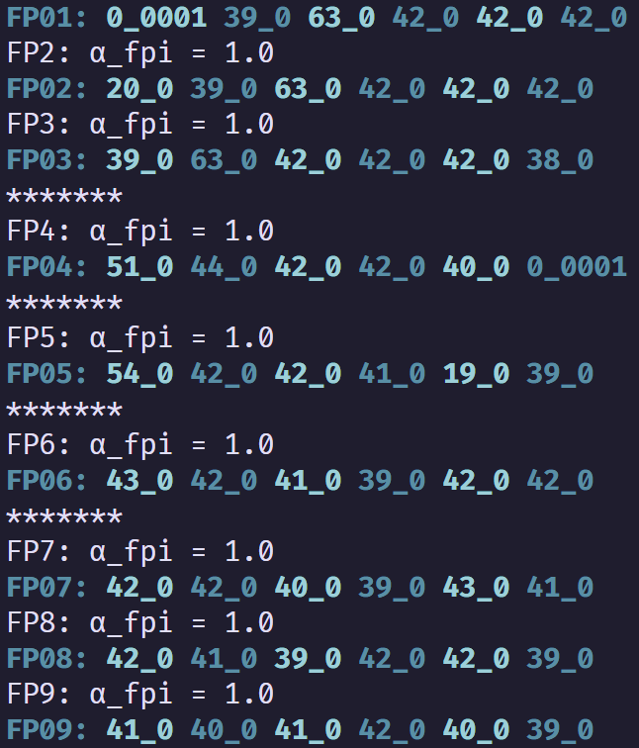
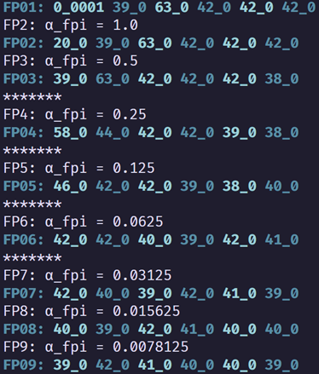
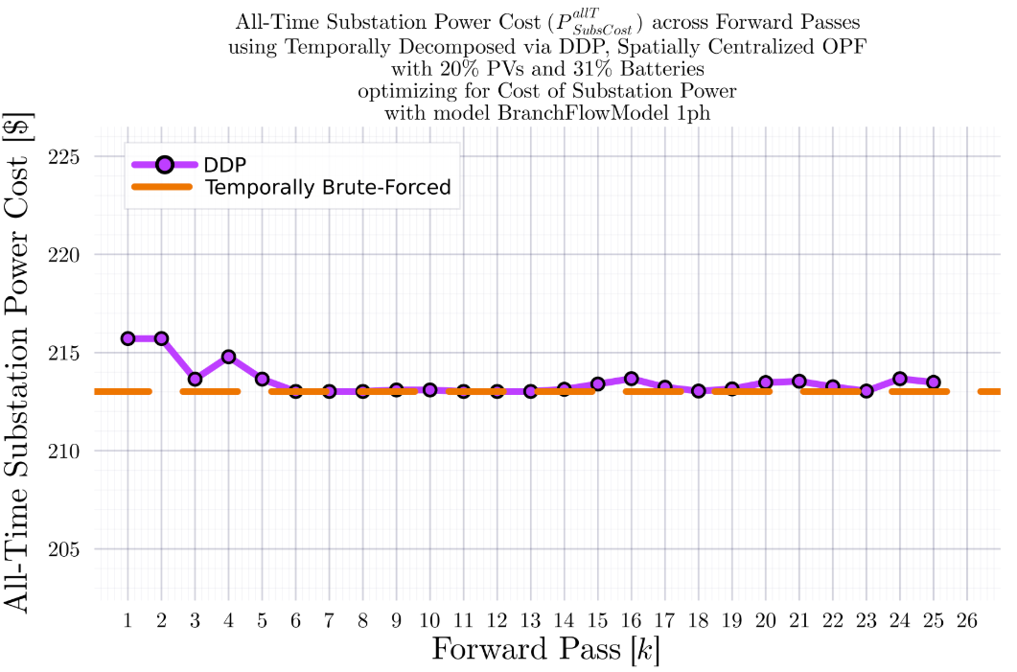
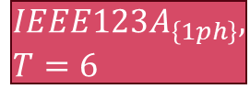
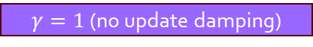

DDP Trajectory vs #Forward Passes $[k]$ Terminal SOC Constraint Relaxed
$$IEEE123A_{\left\{1ph\right\}}, T=6$$
BruteForced (BF)
$$DDP$$
$γ=1$ (no update damping)
$$γ=0.5$$
$γ=1$ (no update damping)
$$γ=0.5$$
$$k_{Max}=25$$

Slide 20
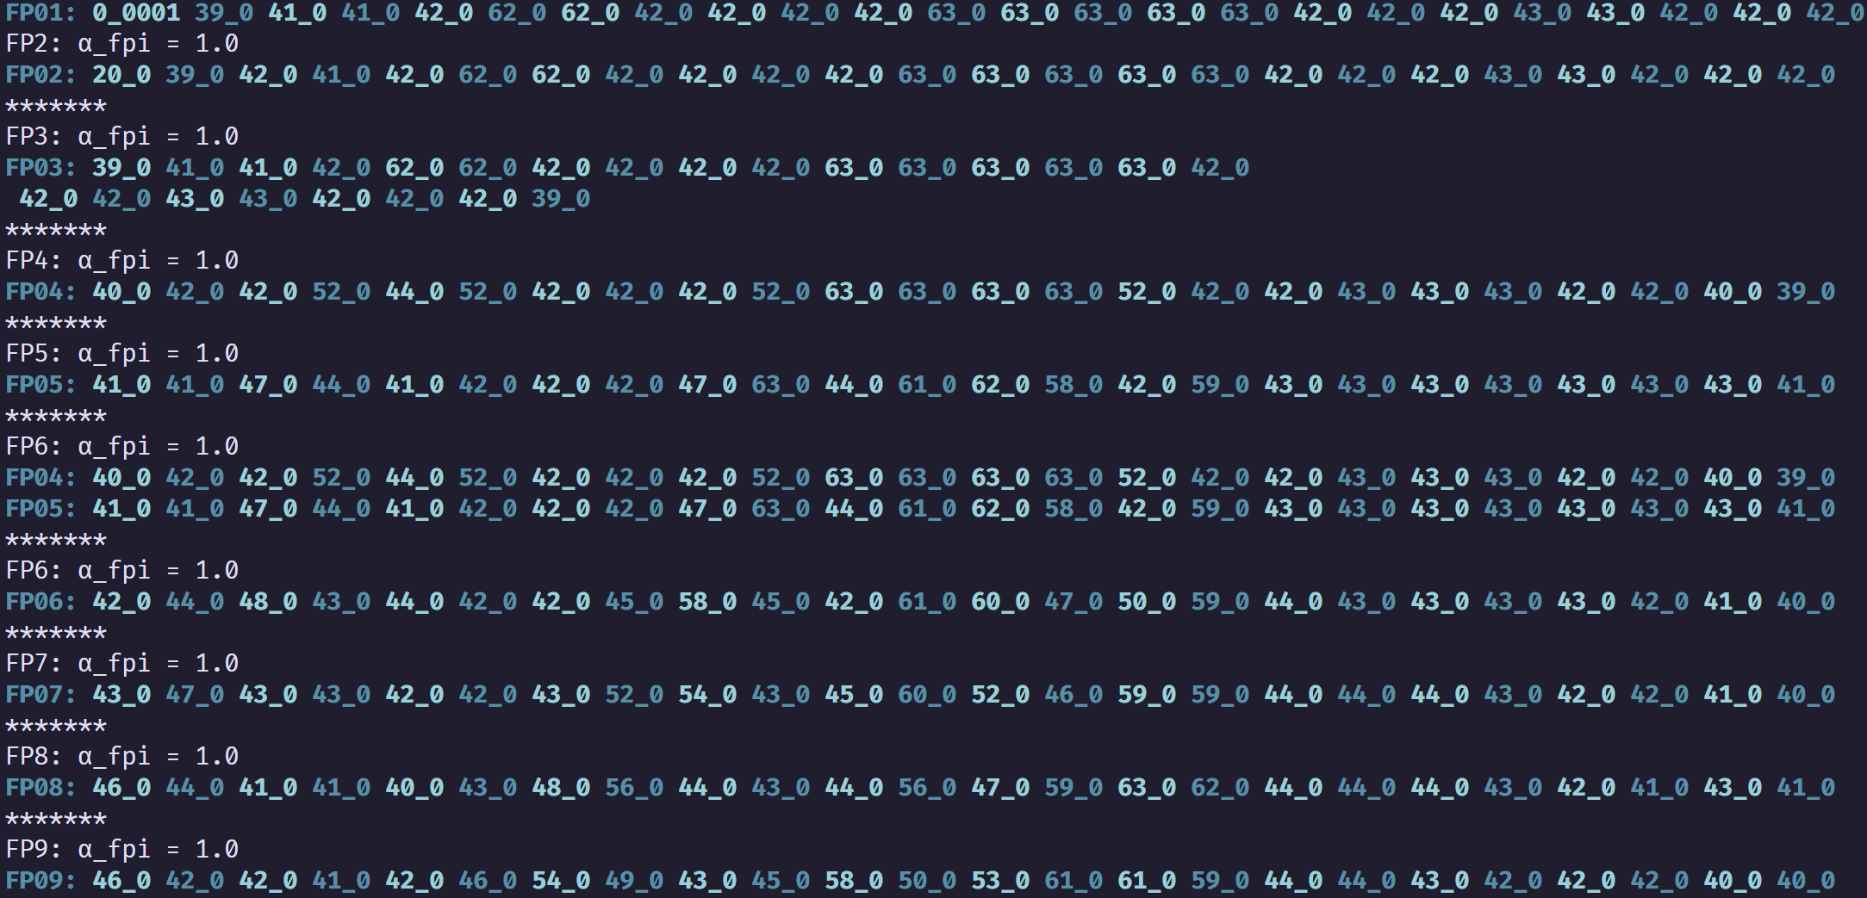
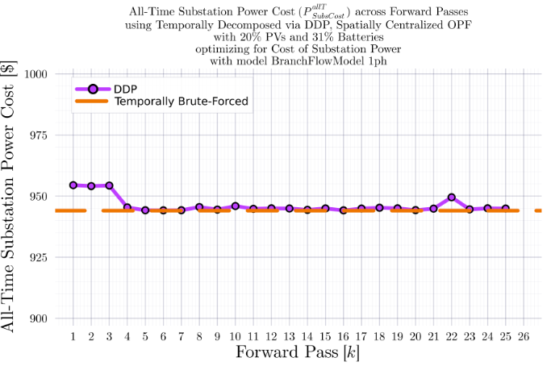
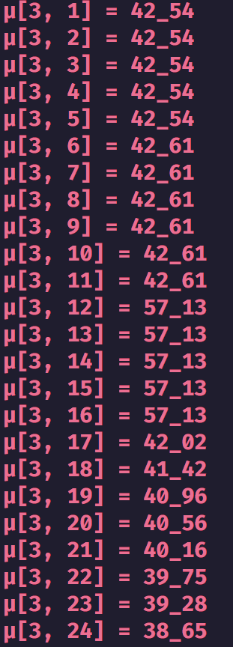
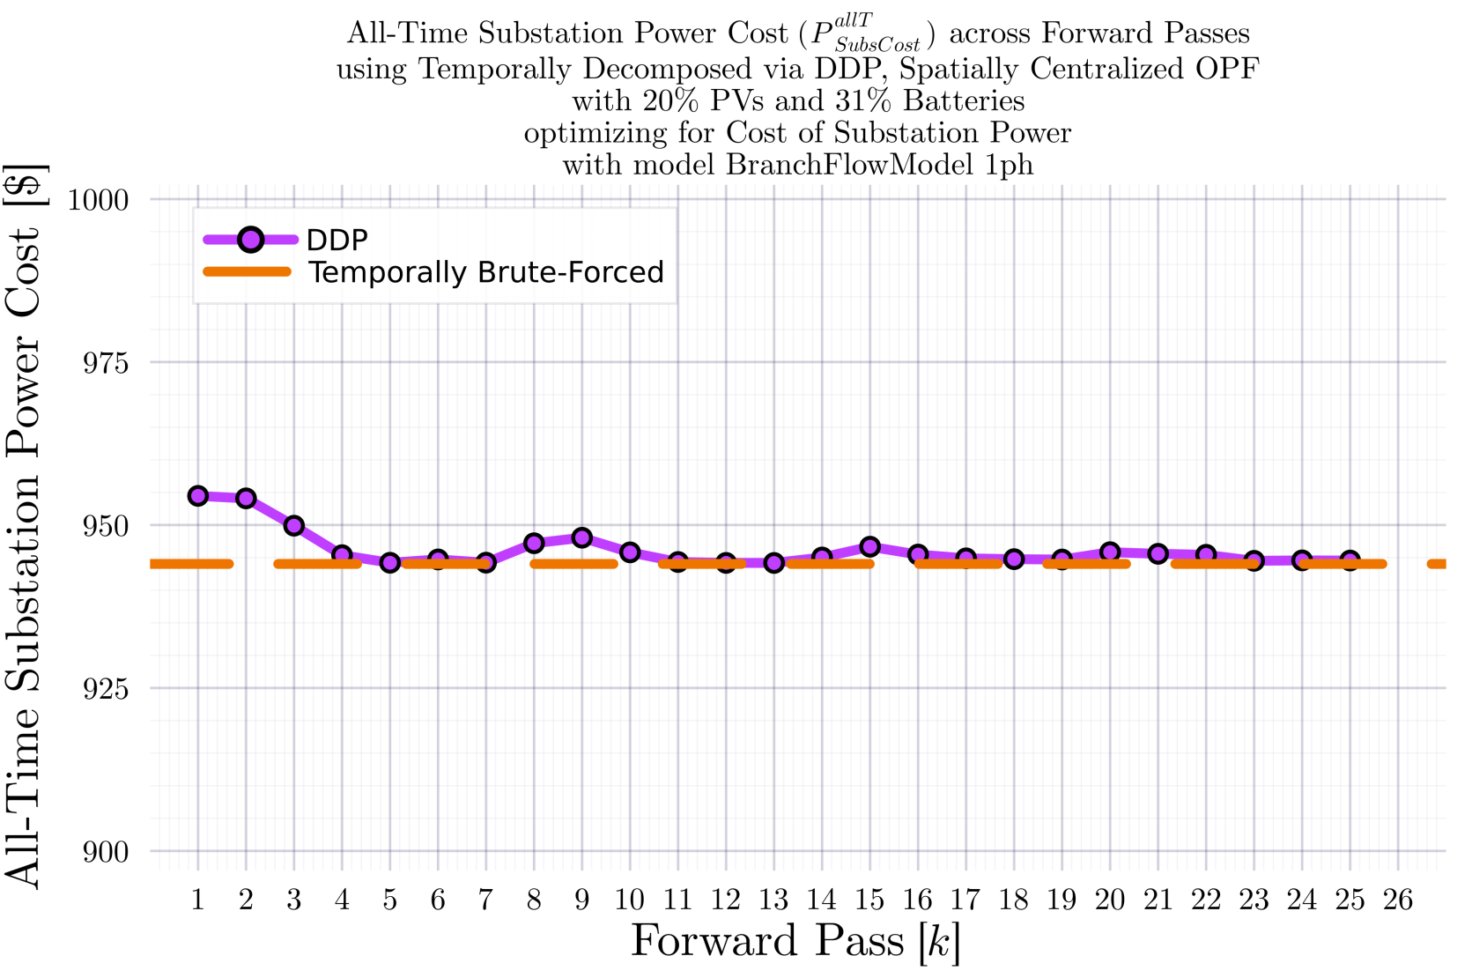

DDP Trajectory vs #Forward Passes $[k]$ Terminal SOC Constraint Relaxed
$$IEEE123A_{\left\{1ph\right\}}, T=24$$
BruteForced (BF)
$$DDP$$
$γ=1$ (no update damping)
$γ=1$ (no update damping)
$$γ=0.5$$
$$γ=0.5$$
$$k_{Max}=25$$

Slide 21



DDP Trajectory vs #Forward Passes $[k]$ Terminal SOC Constraint Relaxed
$$IEEE123A_{\left\{1ph\right\}}, T=96$$
BruteForced (BF)
$$DDP$$
$$k_{Max}=25$$

Slide 22










DDP Trajectory vs #Forward Passes $[k]$ Terminal SOC Constraint Relaxed
$$IEEE123B_{\left\{1ph\right\}}, T=96$$
BruteForced (BF)
$$DDP$$
$γ=1$ (no update damping)
$γ=1$ (no update damping)
$$k_{Max}=25$$

Slide 23








DDP Trajectory vs #Forward Passes $[k]$ Terminal SOC Constraint Relaxed
$$IEEE123B_{\left\{1ph\right\}}, T=24$$
BruteForced (BF)
$$DDP$$
$γ=1$ (no update damping)
$γ=1$ (no update damping)
$$γ=0.5$$
$$γ=0.5$$
$$k_{Max}=25$$

Slide 24




DDP Trajectory vs #Forward Passes $[k]$ Terminal SOC Constraint Relaxed
$$IEEE123B_{\left\{1ph\right\}}, T=24$$
BruteForced (BF)
$$DDP$$
$$k_{Max}=11$$

Slide 25




DDP Trajectory vs #Forward Passes $[k]$ Terminal SOC Constraint Relaxed
$$IEEE123B_{\left\{1ph\right\}}, T=24$$
$$DDP$$
$$k_{Max}=11$$

Slide 26




DDP Trajectory vs #Forward Passes $[k]$ Terminal SOC Constraint Relaxed
$$IEEE123B_{\left\{1ph\right\}}, T=24$$
BruteForced (BF)

Slide 27



DDP Trajectory vs #Forward Passes $[k]$ Terminal SOC Constraint Relaxed
$$IEEE123B_{\left\{1ph\right\}}, T=24$$
BruteForced (BF)
$$DDP$$
$$k_{Max}=7$$

Slide 28



DDP Trajectory vs #Forward Passes $[k]$ Terminal SOC Constraint Relaxed
$$IEEE123B_{\left\{1ph\right\}}, T=24$$
$$DDP$$
$$k_{Max}=11$$

Slide 29


DDP Trajectory vs #Forward Passes $[k]$ Terminal SOC Constraint Relaxed
$$IEEE123B_{\left\{1ph\right\}}, T=24$$
BruteForced (BF)
$$DDP$$
$$k_{Max}=25$$

Slide 30



DDP Trajectory vs #Forward Passes $[k]$ Terminal SOC Constraint Relaxed
$$IEEE123B_{\left\{1ph\right\}}, T=24$$
$$DDP$$
$$k_{Max}=25$$

Slide 31


IEEE 730 1ph Node System
34 12.66kV to 12.66kV branches (high impedance)
43 12.66kV to 0.24kV branches (low impedance)
$$k{V_{B}}_{Sys}=0.24$$
$$kV_{B_{Sec}}=0.24$$
$$kV_{B_{Pri}}=12.66$$
$$MV{A_{B}}_{Sys}=100$$
$$MVA_{B_{Xfm}}=0.07$$
$$Z_{B_{Sys}}=Z_{B_{Sec}}=0.000576$$
$$Z_{B_{Pri}}=1.602756$$
1
2
2
2
1
4
1
1
1
0
1
4
1
1
1
1
2
1
2
1
1
1
1
1
1
1
1
1
1
1
1
1
0
1
0
1

Slide 32


Comparison of BFM-NL-1ph and LinDistFlow-1ph Optimization Results
LinDistFlow Optimal Actions used in OpenDSS
BFM-NL
Optimal Actions used in OpenDSS

Slide 33


Comparison of BFM-NL-1ph and LinDistFlow-1ph Optimization Results
LinDistFlow Own Solutions
BFM-NL Own Solutions

Slide 34


Comparison of BFM-NL-1ph and LinDistFlow-1ph Optimization Results
LinDistFlow
BFM-NL

Slide 35








DDP Trajectory vs #Forward Passes $[k]$ Terminal SOC Constraint Relaxed
$$ADS{10}_{1ph}, T=96$$
BruteForced (BF)
$$DDP$$
Looks ‘successful’
$$k_{Max}=33$$

Slide 36







DDP Trajectory vs #Forward Passes $[k]$ Terminal SOC Constraint Relaxed
$$IEEE{123}_{1ph}, T=96$$
BruteForced (BF)
$$DDP$$
Looks ‘successful’
$$k_{Max}=33$$

Slide 37







DDP Trajectory vs #Forward Passes $[k]$ Terminal SOC Constraint Relaxed
$$ADS{10}_{1ph}, T=24$$
BruteForced (BF)
$$DDP$$
Looks ‘successful’
$$k_{Max}=33$$

Slide 38






DDP Trajectory vs #Forward Passes $[k]$ Terminal SOC Constraint Relaxed
$$IEEE{123}_{1ph}, T=24$$
BruteForced (BF)
$$DDP$$
Looks ‘successful’
$$k_{Max}=33$$

Slide 39







DDP Trajectory vs #Forward Passes $[k]$ Terminal SOC Constraint Relaxed
$$ADS{10}_{1ph}, T=12$$
BruteForced (BF)
$$DDP$$
Will NOT converge
$$k_{Max}=33$$
Even if not converging, it at least does ‘hit’ the optimal value periodically.

Slide 40



DDP Trajectory vs #Forward Passes $[k]$ Terminal SOC Constraint Relaxed
$$ADS{10}_{1ph}, T=12$$
BruteForced (BF)
$$DDP$$
Will NOT converge
$$k_{Max}=55$$
Even if not converging, it at least does ‘hit’ the optimal value periodically.

Slide 41




DDP Trajectory vs #Forward Passes $[k]$ Terminal SOC Constraint Relaxed
$$ADS{10}_{1ph}, T=12$$
BruteForced (BF)
$$DDP$$
Will NOT converge
$$k_{Max}=77$$
Even if not converging, it at least does ‘hit’ the optimal value periodically.

Slide 42




DDP Trajectory vs #Forward Passes $[k]$ Terminal SOC Constraint Relaxed
$$ADS{10}_{1ph}, T=12$$
BruteForced (BF)
$$DDP$$
Will NOT converge
$$k_{Max}=222$$
Even if not converging, it at least does ‘hit’ the optimal value periodically.

Slide 43







DDP Trajectory vs #Forward Passes $[k]$ Terminal SOC Constraint Relaxed
$$IEEE{123}_{1ph}, T=12$$
BruteForced (BF)
$$DDP$$
Will NOT converge
$$k_{Max}=33$$
Even if not converging, it at least does ‘hit’ the optimal value periodically.

